Slide 1
Dame Hilda Lloyd Network
Trainee Tier
Why?

Slide 2
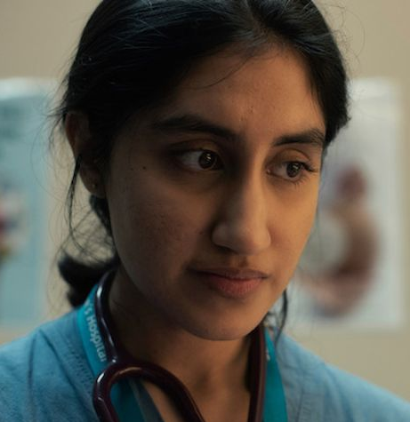
Case Study
“Shruti”
ST2 O&G at West Midlands Hospital
Also considered Neurology and CMT
Interested in care of Women with epilepsy
2 months ago there was a maternal mortality from SUDEP
Notes that neurological conditions are 2nd leading cause of maternal death in the last MBRACE report
Wonders how well care of women with epilepsy is organised in her unit
Notes:
(Mothers and Babies: Reducing Risk through Audits and Confidential Enquiries)

Slide 3
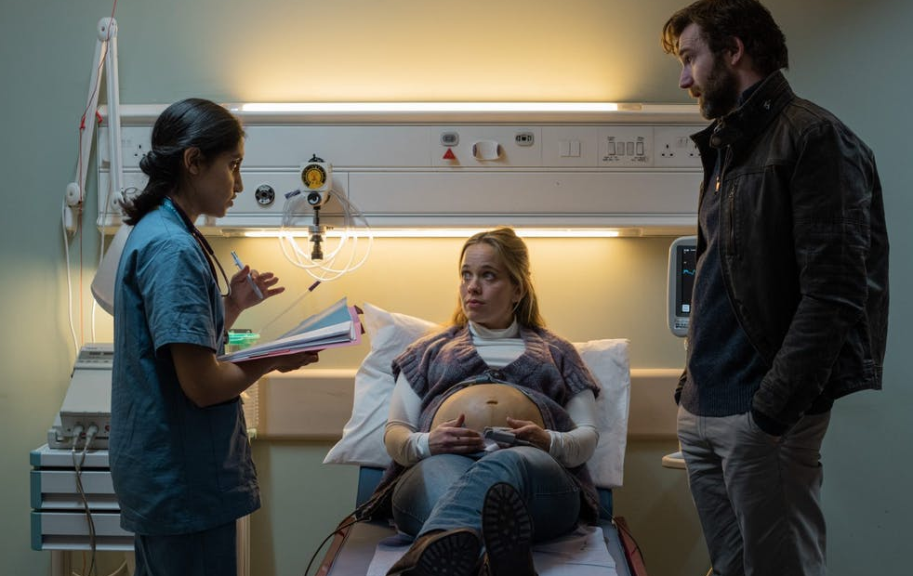
Case Study Contd
Wonders how well care of women with epilepsy is organised around the country?
Are women with epilepsy being seen for pre-pregnancy counselling?
Are they seen and cared for jointly with neurologists?
How can we improve care?
How can we ensure that care is woman centred?

Slide 4
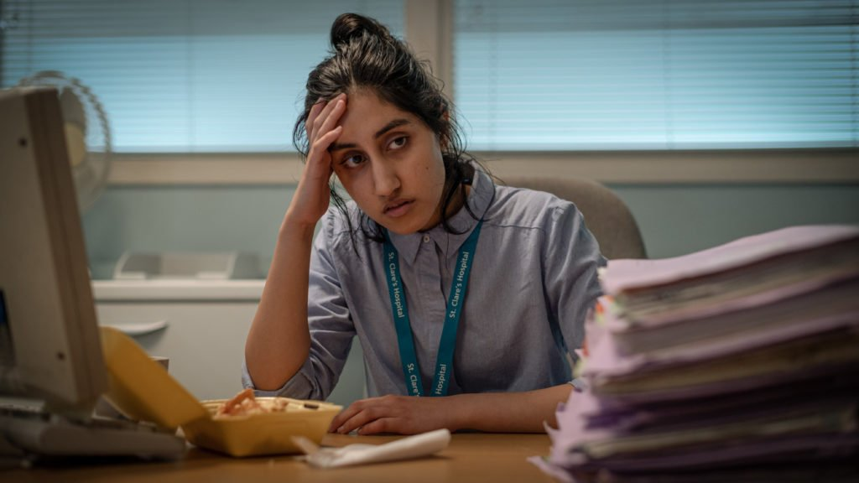
Case Study Contd
Audits care of women with epilepsy in her local unit
Presents findings at unit’s maternity governance meeting.
How do I find out if this is the case in the West Midlands or nationally?
How can I improve education and awareness in primary care and secondary care?
How can I engage women with epilepsy to improve care?

Slide 5
Why are we not doing better?
How can we do better?

Slide 6
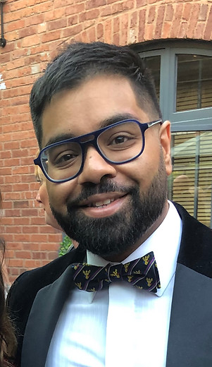
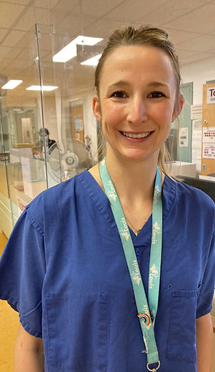
Trainee tier
Co-Leads
Jay Ghosh
ST5 O&G
Worcester
Jenny Tamblyn
SST O&G
Leeds
Notes:
I am an O&G ST5 currently at WRH, I graduated Medical School from Imperial College with an BSc in Healthcare management in 2012, started training in O&G in 2014, finished my PhD in Risk factors and management of miscarriage in 2021 from UoB supervised by Prof AC and IDG and funded by Tommys. My interests are in early pregnancy, fertility and benign gynaecology and healthcare management
Jenny is an SST ST6 in Reproductive Medicine and Surgery in Leeds supervised by Prof AB, she graduated medical school from UoB in 2011, started training in 2013 as an ACF before doing her PhD in Vitamin D effects on immune cell function on human decidua supervised by Prof MK and MH funded by WoW, she then became an ACL supervised by Prof AC and MK. Her research interests are in Vitamin D, miscarriage and implantation.

Slide 7
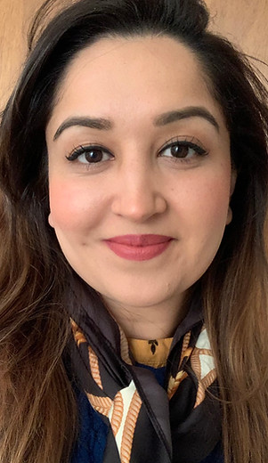
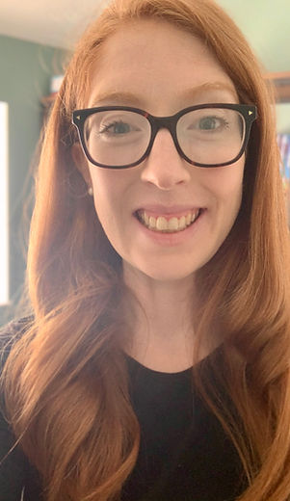
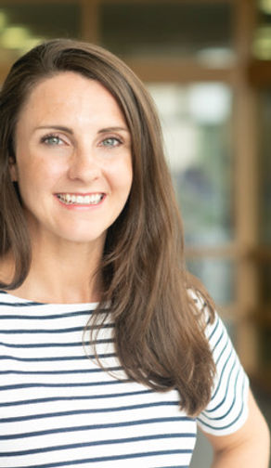
Trainee tier
Hajra Khattak
ST3 O&G
Bham Women’s
Teaching Lead
Naomi Black
CRF O&G
Warwick
Clinical Lead
Lauren Ewington
ST4 O&G
Bham Heartlands
Research Lead
Notes:
Hajra is an ST3 at BWH, she graduated from Southampton in 2014, started training in 2016, currently finishing her PhD on assessing the effectiveness of ovarian tissue transplantation for preserving reproductive and endocrine function supervised by Profs AC IDG and AT and her research interests are in fertility, early pregnancy and medical education.
Naomi is a CRF ST3 at UoW doing a PhD supervised by Prof SQ, she graduated medical school from Imperial College in 2016 with a BSc in gastroenterology, started training in 2018 as an ACF supervised by Prof SQ and her interests are in RM and EP
Lauren is an ST4 at UHB, she graduated medical school from Imperial College in 2012 with a BSc in Reproductive and Developmental biology, started training as an ACF in 2015 under Prof SQ, has a MSc in Health Research from UoW and is also writing up her PhD at UoW on managing fetal macrosomia again supervised by Prof SQ and Prof Anne-Marie Slowther. Her research interests are in fetal macrosomia, medical ethics and IOL

Slide 8
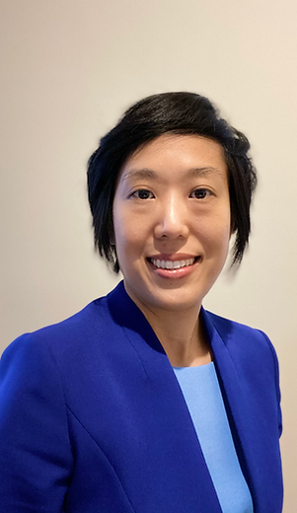
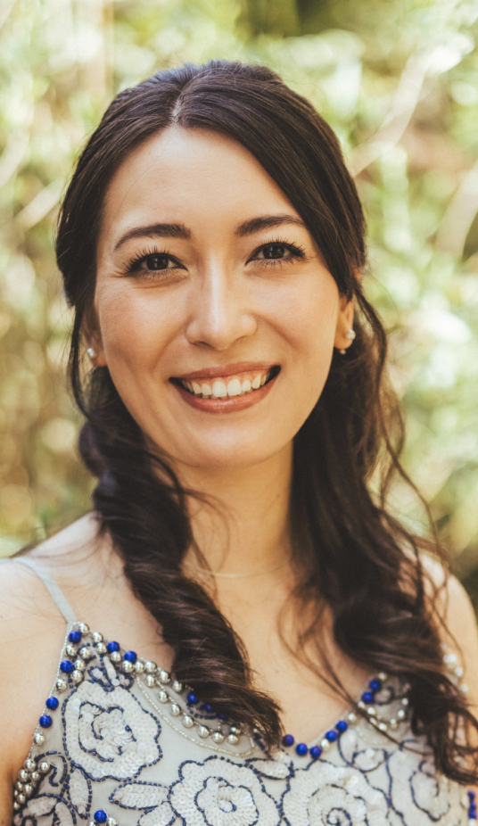
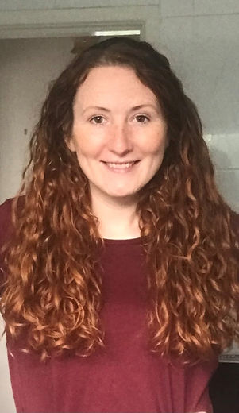
Trainee tier
Elaine Leung
ACL ST6 O&G
Bham City
Liason Lead
Emily Fox
ST1 O&G
Worcester
Co-Publicity Lead
Tanya Bodenham
ST2 O&G
Bham City
Co-Publicity Lead
Notes:
Elaine is an NIHR ACL in Gynae oncology and ST6 at City Hospital Bham supervised by Prof SS, she graduated medical school from Glasgow in 2009, started her training in NE Thames as an ACF in 2011, has a Masters in clinical research in 2014 from Glasgow, finished her PhD on NK cells and oncolytic adenovirus in ovarian cancer funded by the Welcome Trust in 2018 from Glasgow supervised by Prof Iain McNeish. Her research interests are in gynae onc.
Emily is an O&G ST1 at WRH, she did her undergraduate at UoBham 2015, graduated medical school from Cambridge in 2019, was an AFP in Wolverhampton and started training in O&G in 2021. Her interests are in gynae onc but is developing interests in fertility and recurrent miscarriage.
Tanya is an O&G ST2 at City Hospital Bham, she did her undergraduate in Cardiff in 2010, a PhD also from Cardiff on the interactions of cytokines in peritoneal fibrosis supervised by Prof Donald Fraser, graduated medical school from Cambridge in 2018 and started training in O&G in 2020, her interests are in Acute Gynae and early pregnancy

Slide 9

Case Study Contd
Wonders how well care of women with epilepsy is organised around the country?
Are women with epilepsy being seen for pre-pregnancy counselling?
Are they seen and cared for jointly with neurologists?
How can we improve care?
How can we ensure that care is woman centred?

Slide 10
I don’t know how to do this…
I need some help and guidance…

Slide 11
How can DHL help?
Dame Hilda Lloyd Network Mentorship Scheme

Slide 12
Dame Hilda Lloyd Network Mentorship Scheme
Purpose of the scheme
One to one mentoring
Taster in research
Develop research skills
Career development
Collaboration and knowledge sharing
Help with an ongoing project (systematic review, recruitment to studies etc.)
Who can apply?
Trainees in O&G
Doctors with an interest in O&G (foundation doctors)
Medical students
Nurses/Midwives

Slide 13
Potential mentors
Academic Clinical Fellows (ACFs)
Clinical Research Fellows (CRFs)
Post-doctoral fellows
Academic Clinical Lecturers (ACLs)
Clinical academics (consultants/professors)
Women’s health researchers
Duration of mentoring arrangements
6 months (but can be extended to a further 6 months)
Meeting frequency
4-6 meetings (face-to-face/ virtual)
Agree to a report submitted to the DHL at the end (to be published on website)

Slide 14

Approach the DHL trainee tier
Register your interest
Contact h.khattak@doctors.org.uk

Slide 15
Thank you

