Slide 1
Dame Hilda Lloyd Network: Medical Student Tier
Devika Nair – Y5 medical student
Jameela Sheikh – Y4 medical student

Slide 2
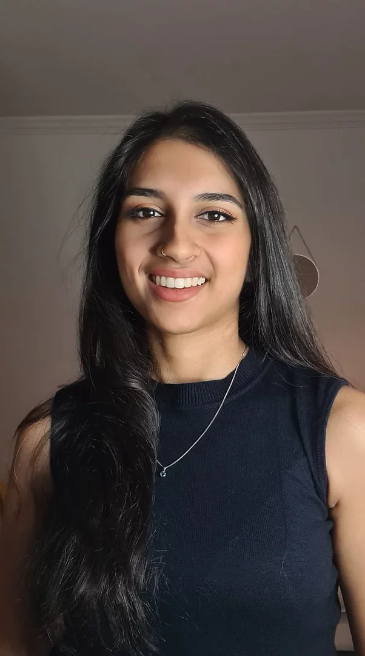
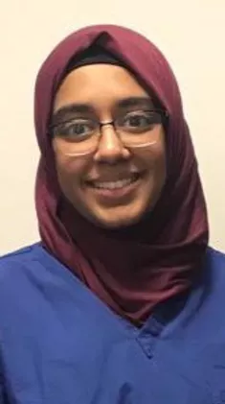
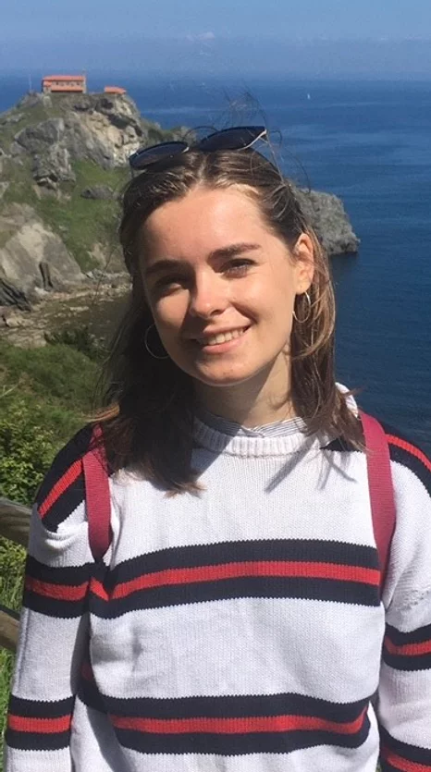
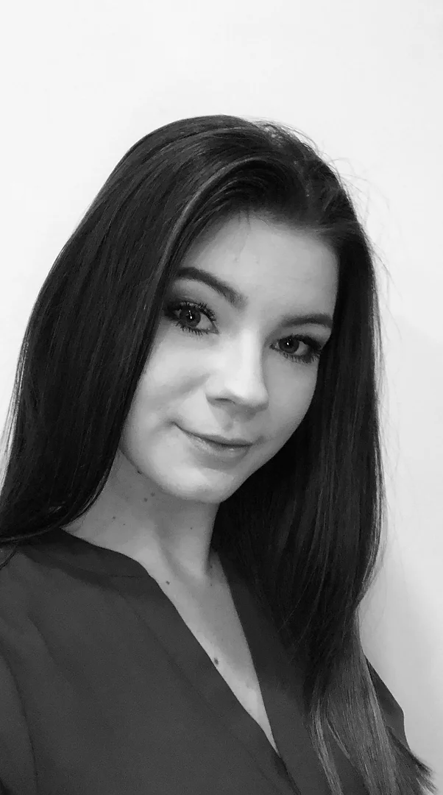
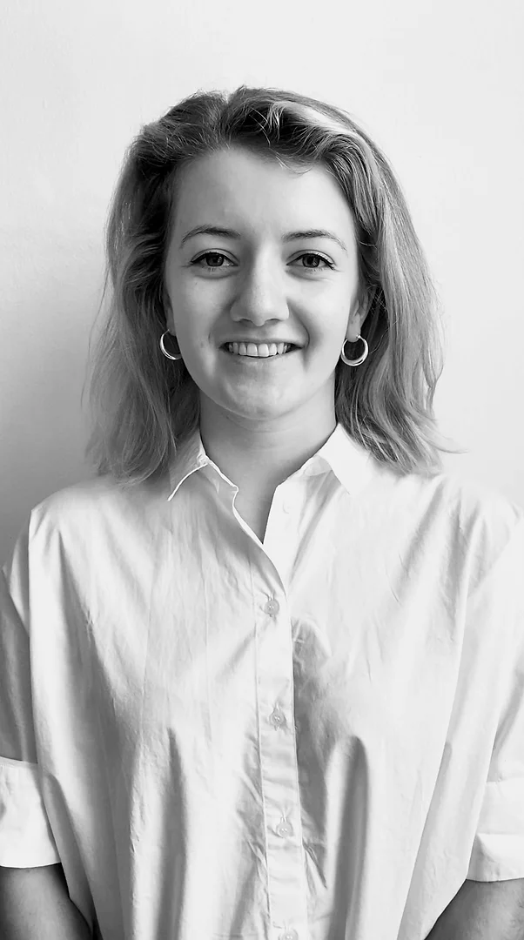
Medical Student Tier
Student Lead | Publicity Lead | Teaching Lead | Clinical Lead | Research Lead
Devika Nair | Jameela Sheikh | Ella Marson | Emily Taylor | Isobel Trout

Slide 3
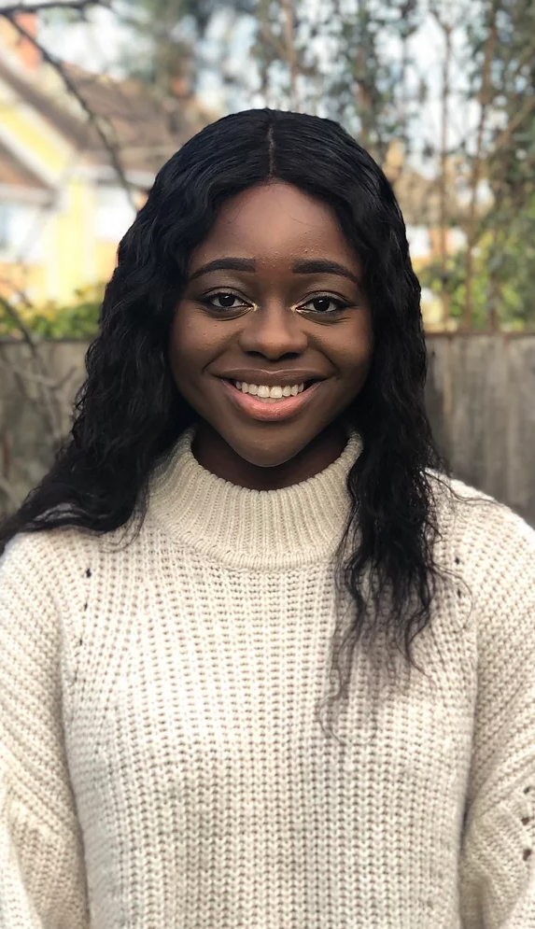
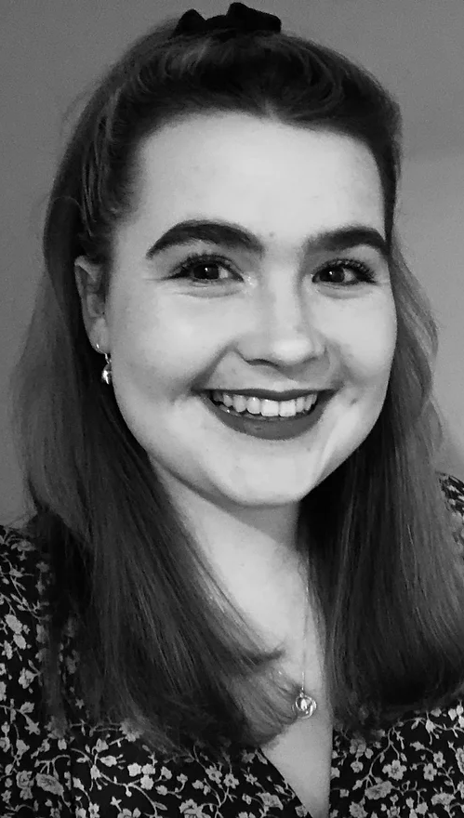
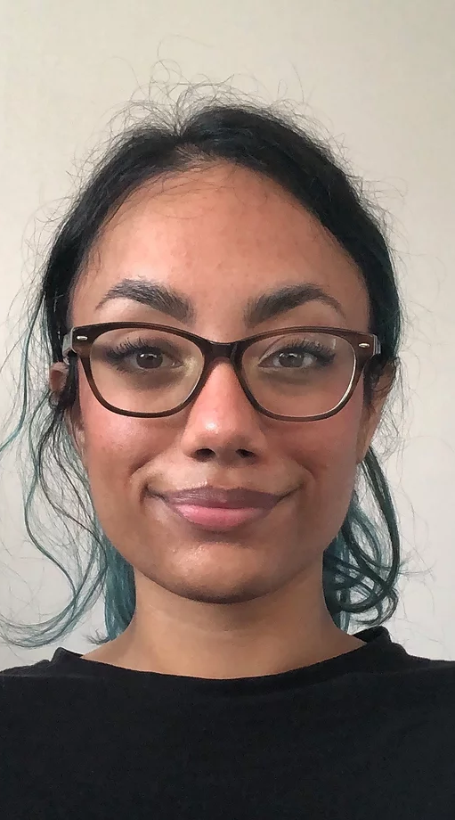
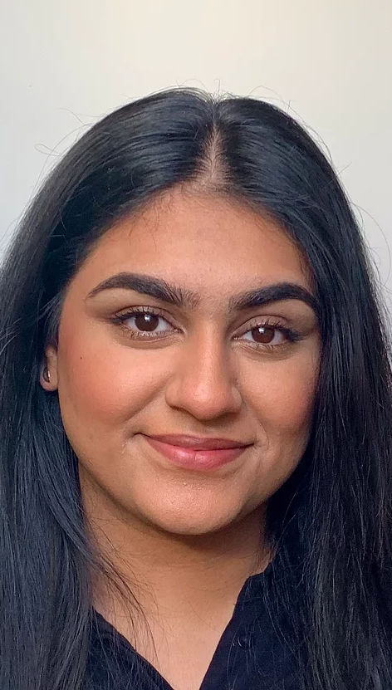
DHL Champions
Adeolu Banjoko | Danielle Sutherland | Millie Manning | Kiran Khamb | Gurkiran Bhogal
Organisation of regional audits
Conduct research within hospital placements
Volunteer at events
Notes:
Rcognised for their commitment and involvement in the DHL network

Slide 4
Logo Competition - JS

Slide 5
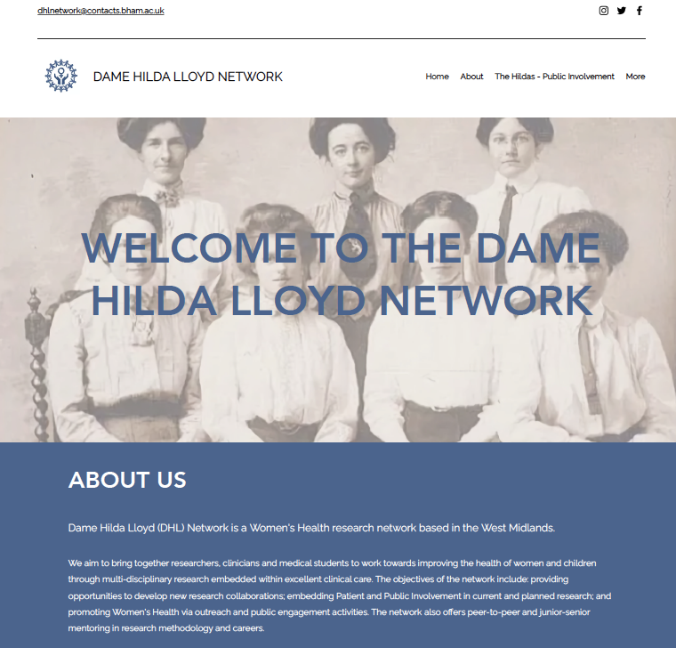
Social Media & Website

Slide 6
Research: Care of pregnant women with epilepsy in the UK
Led by Emily Taylor
April – October 2021
144 HCP from 94 hospitals and 77 NHS Trusts
Manuscript submitted to EJOG and work presented at national conferences

Slide 7
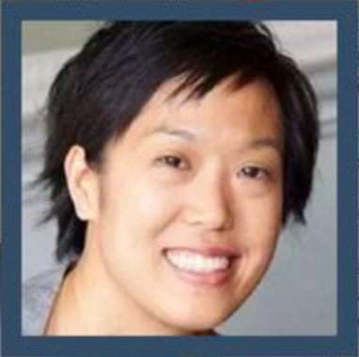
How to Successfully Navigate the Academic Pathway in Women's Health
Dr Elaine Leung
Zoom webinar
Considering a career in Women's Health/AFP
Highlights of being an academic clinician in O&G
Advice and tips on CV and interviews.
Notes:
A zoom webinar was conducted by Dr Elaine Leung, NIHR acaemic clinical lecturer in gynaecological oncology. It was catered to anybody applying for academic foundation programme and explored academic careers in Women’s Health. Topics discussed included the highlights of being an academic clinician in Obstetrics and Gynaecology, and Dr Leung also provided advice on enhancing your CV and how to approach interviews. Furthermore, Dr Leung was able to answer questions that attendees had regarding life as an academic clinician.

Slide 8
School student engagement
School student committee
Lectures
Essay competition
Opportunity to shadow researchers

Slide 9
Life as a Medical Student
DHL Student Champion
Sixth form students who have applied to/aspire to apply to study Medicine at university
Application process
Tips to know before starting
A day in the life of an SHO
Notes:
We were able to organise a talk for students of a Birmingham school on the topic of life as a medical student. This was presented by Gurkiran, one of our student champions. She spoke to sixth form students interested in a career in medicine. Topics covered included advice on the application process and details of how to manage time as a medical student. We also had an SHO present who was able to talk about her experiences working as a doctor.

Slide 10
Essay competition
Year 12-13 students interested in a career in healthcare
What has been the most valuable contribution to women's health over the past 100 years?
What are the barriers to refugee women's health?
Discuss the health inequalities in women's health globally.
Notes:
Proud to organise our first essay competition, open to sixth form students interested in a career in health. We asked students to write a 2000 word essay on one of the following titles. Students were encouraged to conduct their own literature search and discuss the topic of their choice with justifications. We received a number of interesting sumbmission but are happy to announce today the winners of the competition

Slide 11
Essay competition
Winner:
Fatima Hussien Hado
What Are the Barriers to Refugee Women’s Health?
Runner up:
Louise Osborne
Inequalities in Women’s Health Globally
Notes:
Fatima Hado who chose to write on the topic of What are the barriers to refugee womens health? Her essay was well structured and presented, with clear identification of several relevant barriers to refugee women’s health
And we are also please to announce the runner up as Lpuise Osborne, whose essay explored the inequalities in Womens helath globally. Her essay was thoroughly researched and her passion for the subject was clear in her writing. She presented some interesting arguments regarding female inequality in relation to cardiovascular disease, which is still perceived as a male predominant disease.
We would like to invite both Fatime and Louise on stage now to be awarded their certiifcates.

